Slide 1

A B C D E F G H I
Pick the one that doesn’t fit the group.
Notes:
Answer: IIIrd figure

Slide 2
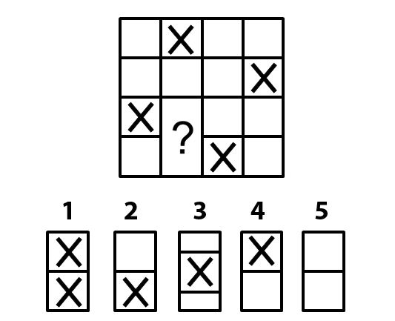
Find the missing part.
Notes:
Answer is 5

Slide 3

Pick the one that doesn’t fit the group.
Notes:
Answer E

Slide 4
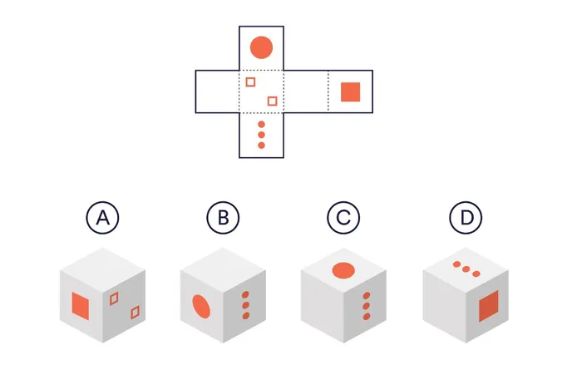
Which cube face is correct.
Notes:
D

Slide 5
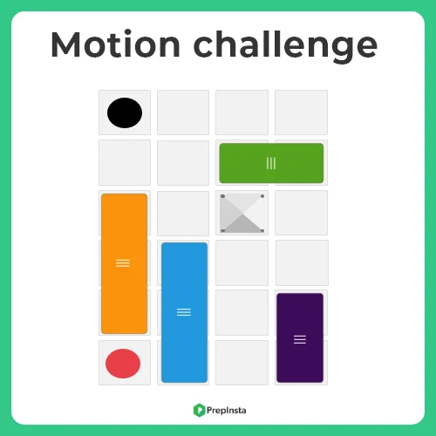
A) 3 steps B) 4 steps C) 6 steps D) 8 steps
In how many minimum numbers of steps you can move the red ball to the hole.
Notes:
Answer A

Slide 6
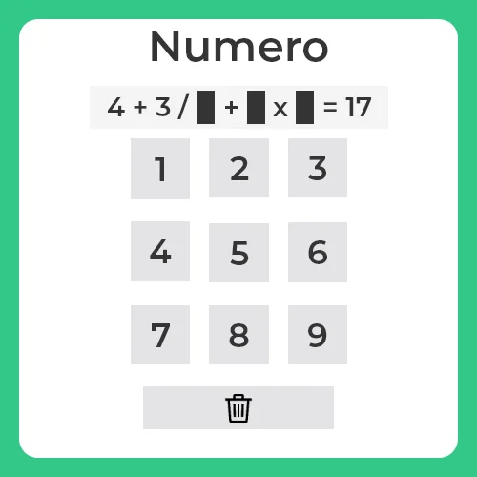
Solve the following equation A) 3,5,2 B) 3,4,1 C) 3,6,2 D) 2,5,3
Notes:
Answer C

Slide 7
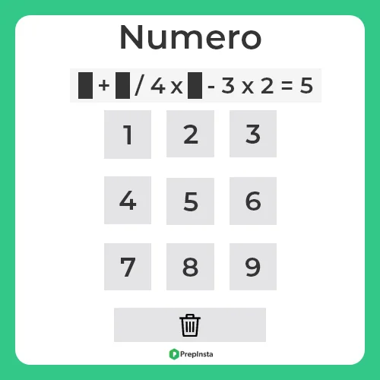
Solve the following equation A) 4,8,1 B) 3,8,2 C) 2,4,8 D) 3,8,4
Notes:
Answer D

Slide 8
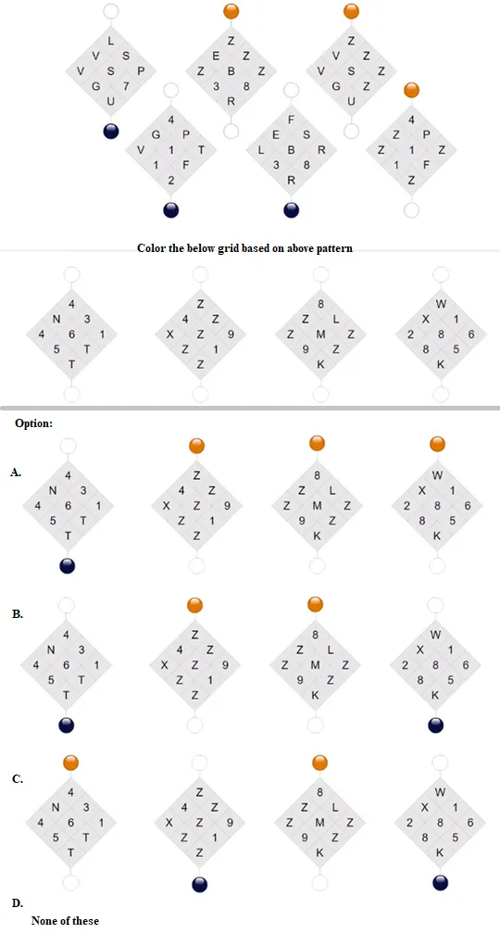
Identify the pattern in which the question grids are coloured and following the same pattern colour the given grids.
Notes:
Answer B

Slide 9
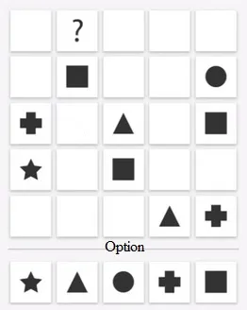
A B C D E
Please choose the correct option.
Notes:
Answer A

Slide 10
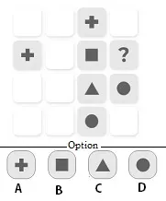
Notes:
Answer C

Slide 11
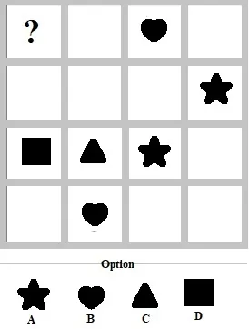
Notes:
Answer C

Slide 12
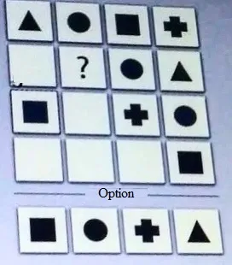
A B C D
Notes:
Answer A

Slide 13
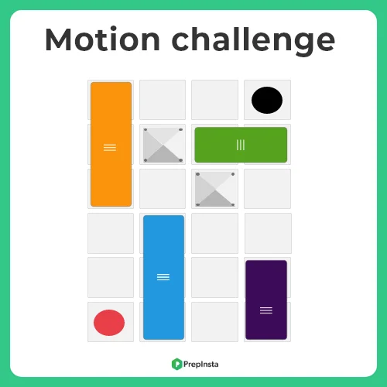
A) 7 steps B) 5 steps C) 8 steps D) 3 steps
In how many minimum numbers of steps you can move the red ball to the hole.
Notes:
Answer B

Slide 14
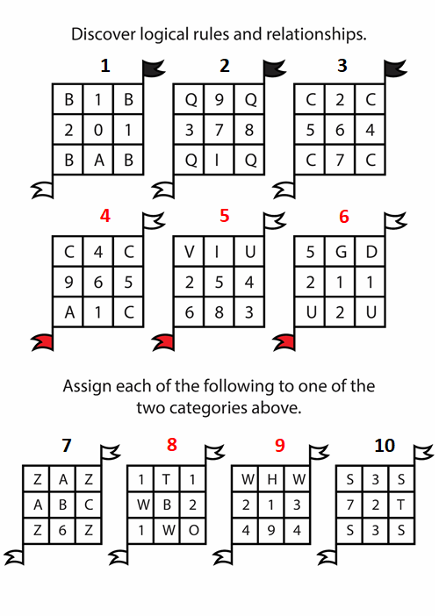
Notes:
4 same alphabets at corner then black flag

Slide 15
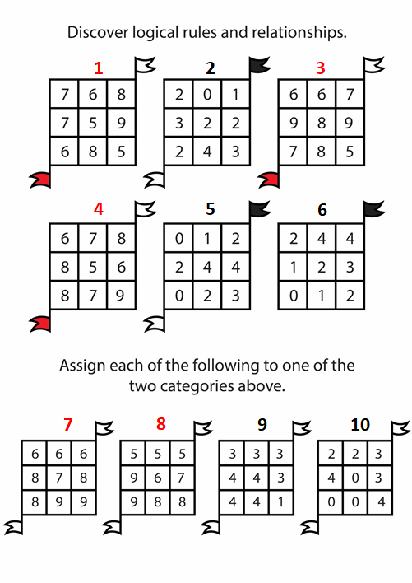
Notes:
Red flag for number greater than or equal to 5
Black flag for number less than or equal to 4

Slide 16
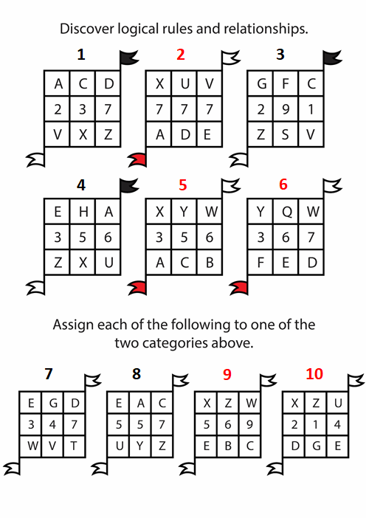

Slide 17
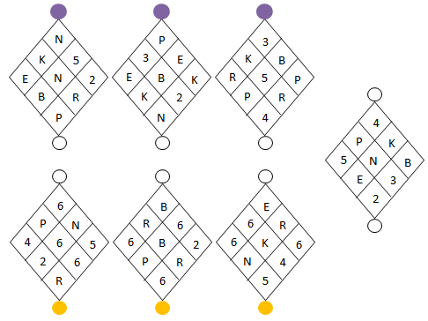
Notes:
Three 6’s then orange otherwise purple

Slide 18
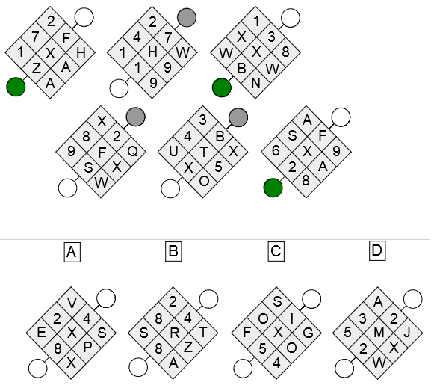
Notes:
It is possible to establish very quickly that the green category diagrams all have an X in their center. This information is sufficient to separate the two categories and thus solve the exercise. Diagrams A and C therefore belong to the green category, whilst diagrams B and D belong to the grey category

Slide 19
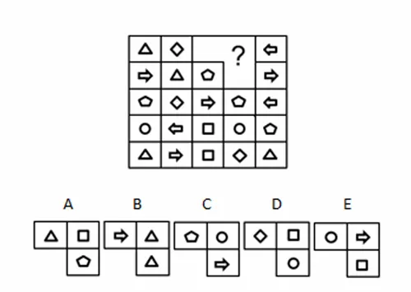
Notes:
the correct answer is (D).
In each row and in each column, one and only one of the shapes appears twice.

Slide 20
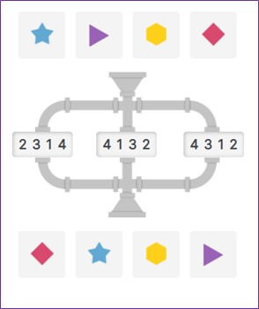
a) 2314 b) 4132 c) 4312
Notes:
4132

Slide 21
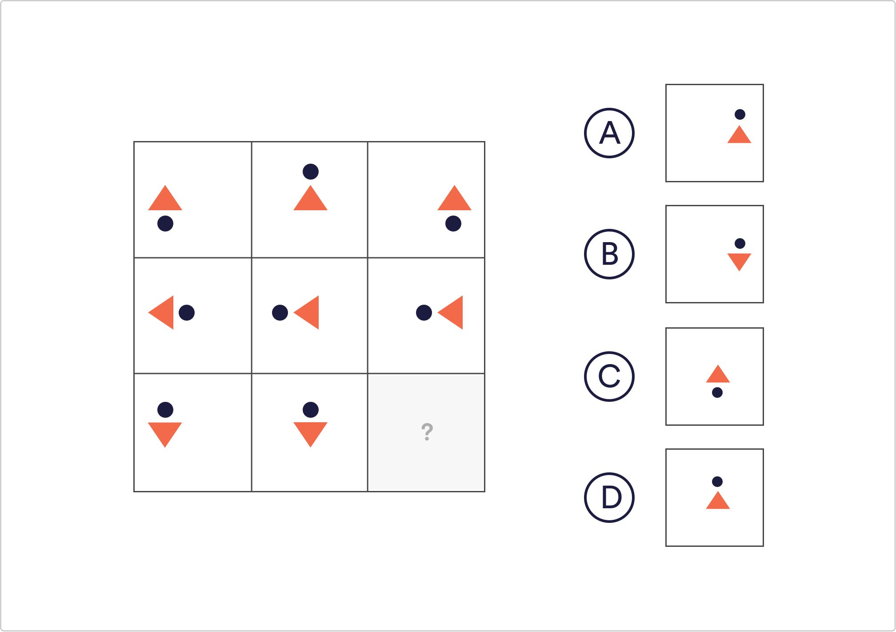
Which of the given shapes would complete the sequence?
Notes:
The only shape that is important to note in this example is the orange triangle. It is positioned within its square according to the square’s position in the image. The triangles in the left hand column are positioned to the left, the triangles in the middle column are centred in their corresponding squares and the same for the right hand side.
Correct Answer; B

Slide 22
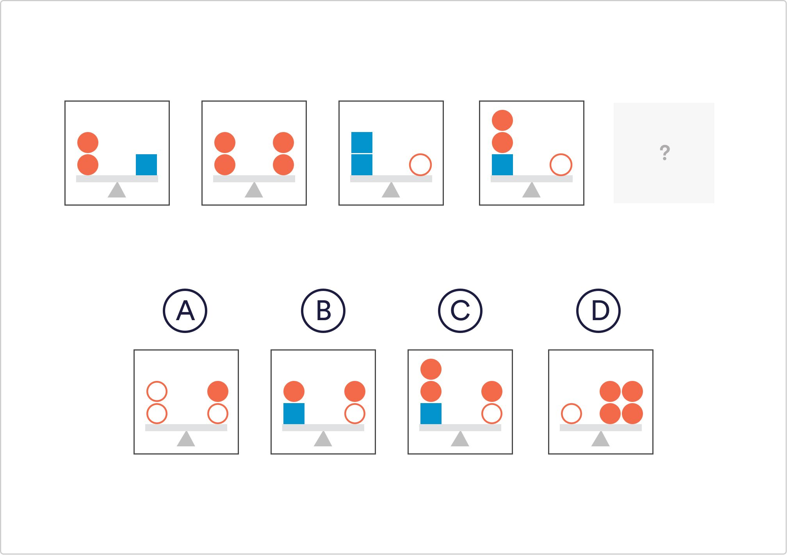
Which of the given shapes fits the pattern in the sample images?
Notes:
Correct Answer; D
This question is asking you to identify the relationship between the 3 shapes. The shapes on the left of the scale represent the same value as those shapes on the right. From the first image we can work out the 2 orange circles equate to one blue square. Similarly, two blue squares equate to one white circle. Therefore: 1 white circle = 2 blue squares = 4 orange circles.

Slide 23
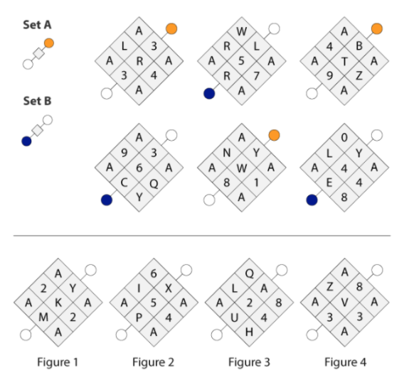
Notes:
Four same alphabets then orange color

Slide 24
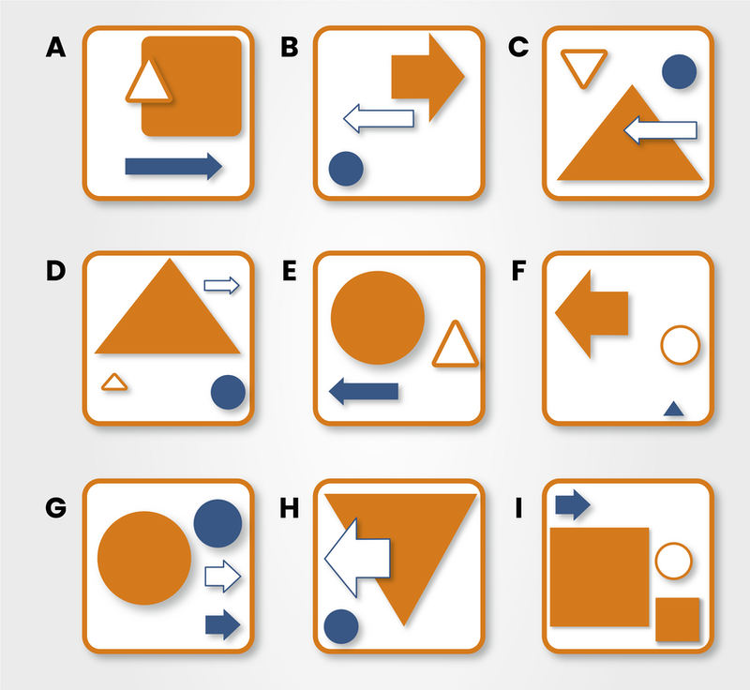
Identify the odd one out
Notes:
The first is that the largest shape must be grey, and the second is that the bottom shape must be black.
The odd one out is, therefore, C, as the bottom shape is stripey and not black.

Slide 25
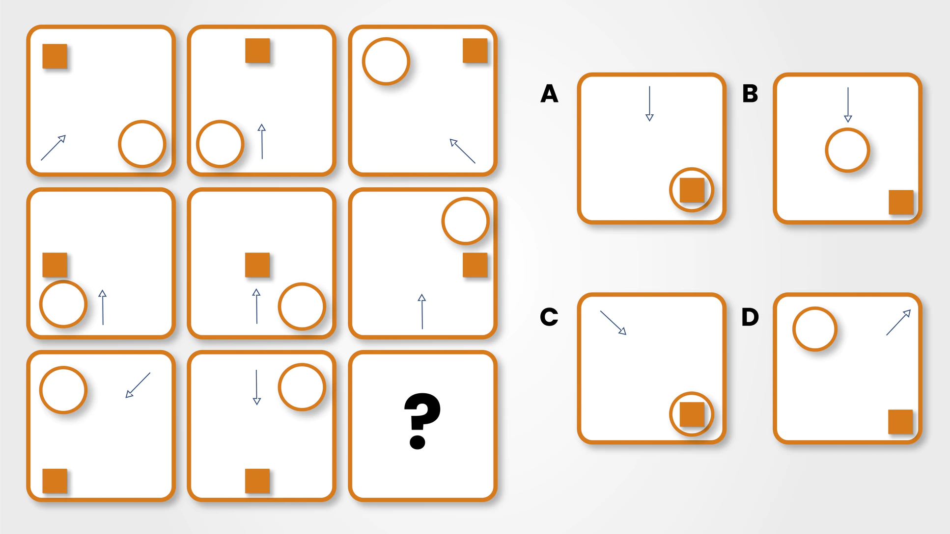
Identify the missing square
Notes:
There are three rules to spot in this question.
Firstly, there is a relative positional rule: the position of the black square corresponds to the position its square holds within the diagram.
Secondly, there is a movement rule, in that the circle moves around the boxes in a clockwise position.
Finally, the arrows in the first and third columns are reflections of one another. The correct answer is therefore C.

Slide 26
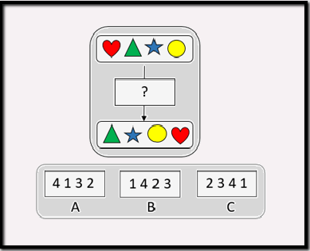
Notes:
Answer C

Slide 27
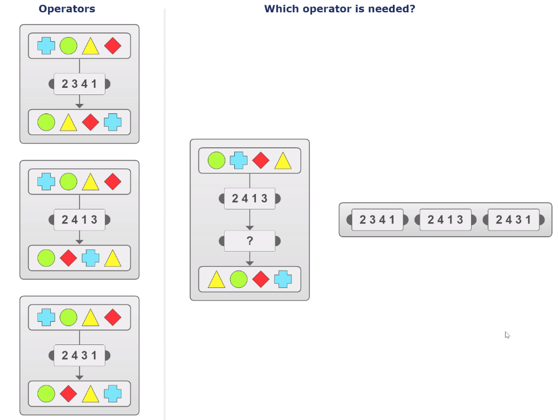

Slide 28
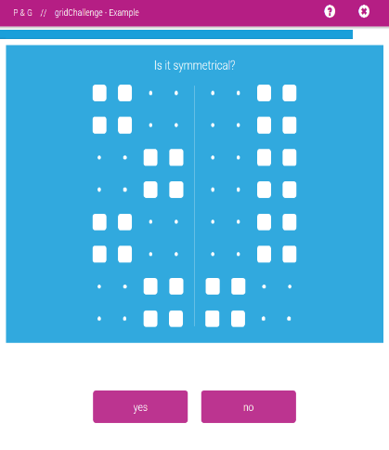
Notes:
No

Slide 29
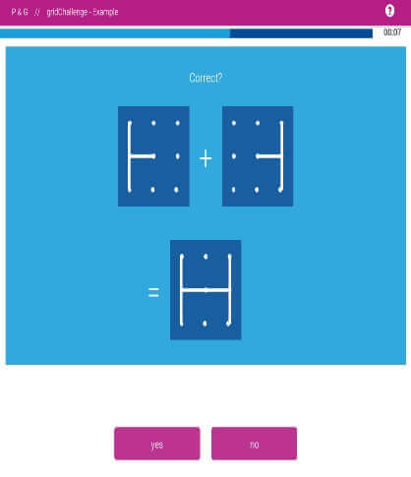
Notes:
Yes

